Slide 1

NAKUJA INTERNSHIP 2024
Airframe Week 5 Presentation

Slide 2
Tasks this week
#78 Ways of increasing the stability of the rocket
#67 Rivet Strength Calculations
#76 Launch pad inspection
#77 Strength Calculation of AA1050
Material Acquisition

Slide 3
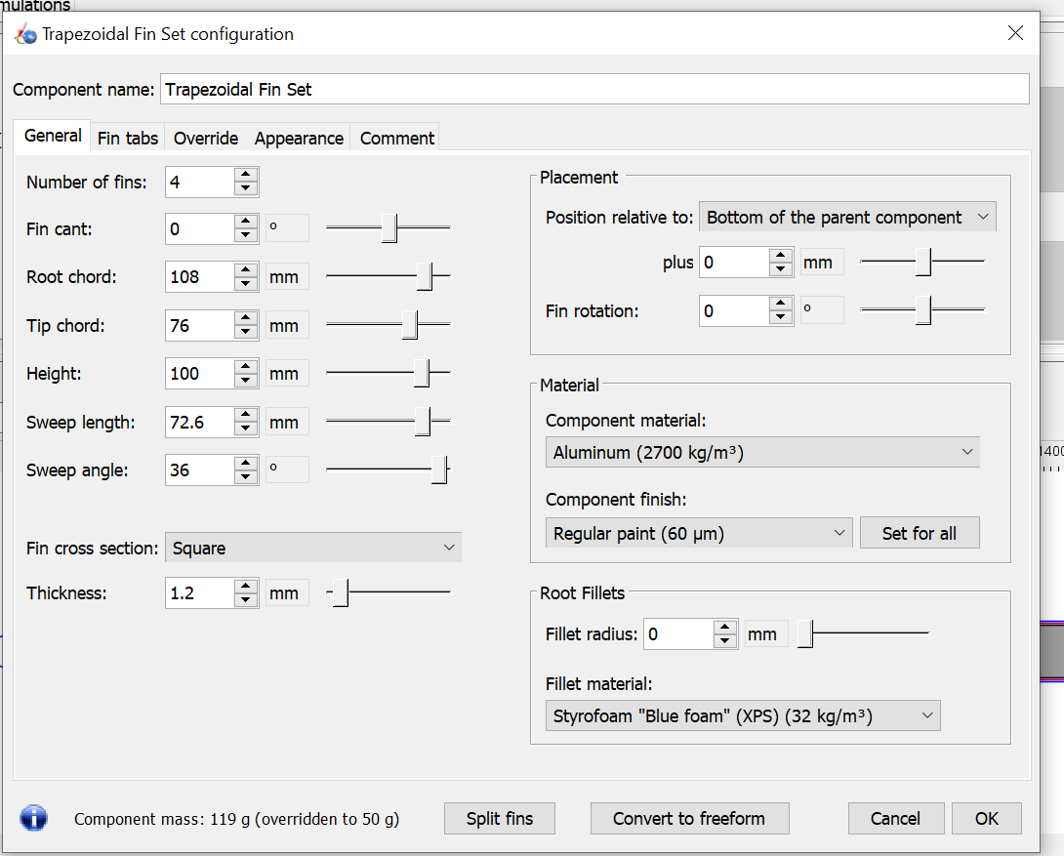
Ways of increasing the stability of the rocket
To increase stability;
Lower the center of pressure by increasing the area of fins
Raise the Center of gravity by increasing the mass at the upper part of the body, i.e the Nose cone and upper body tube

Slide 4
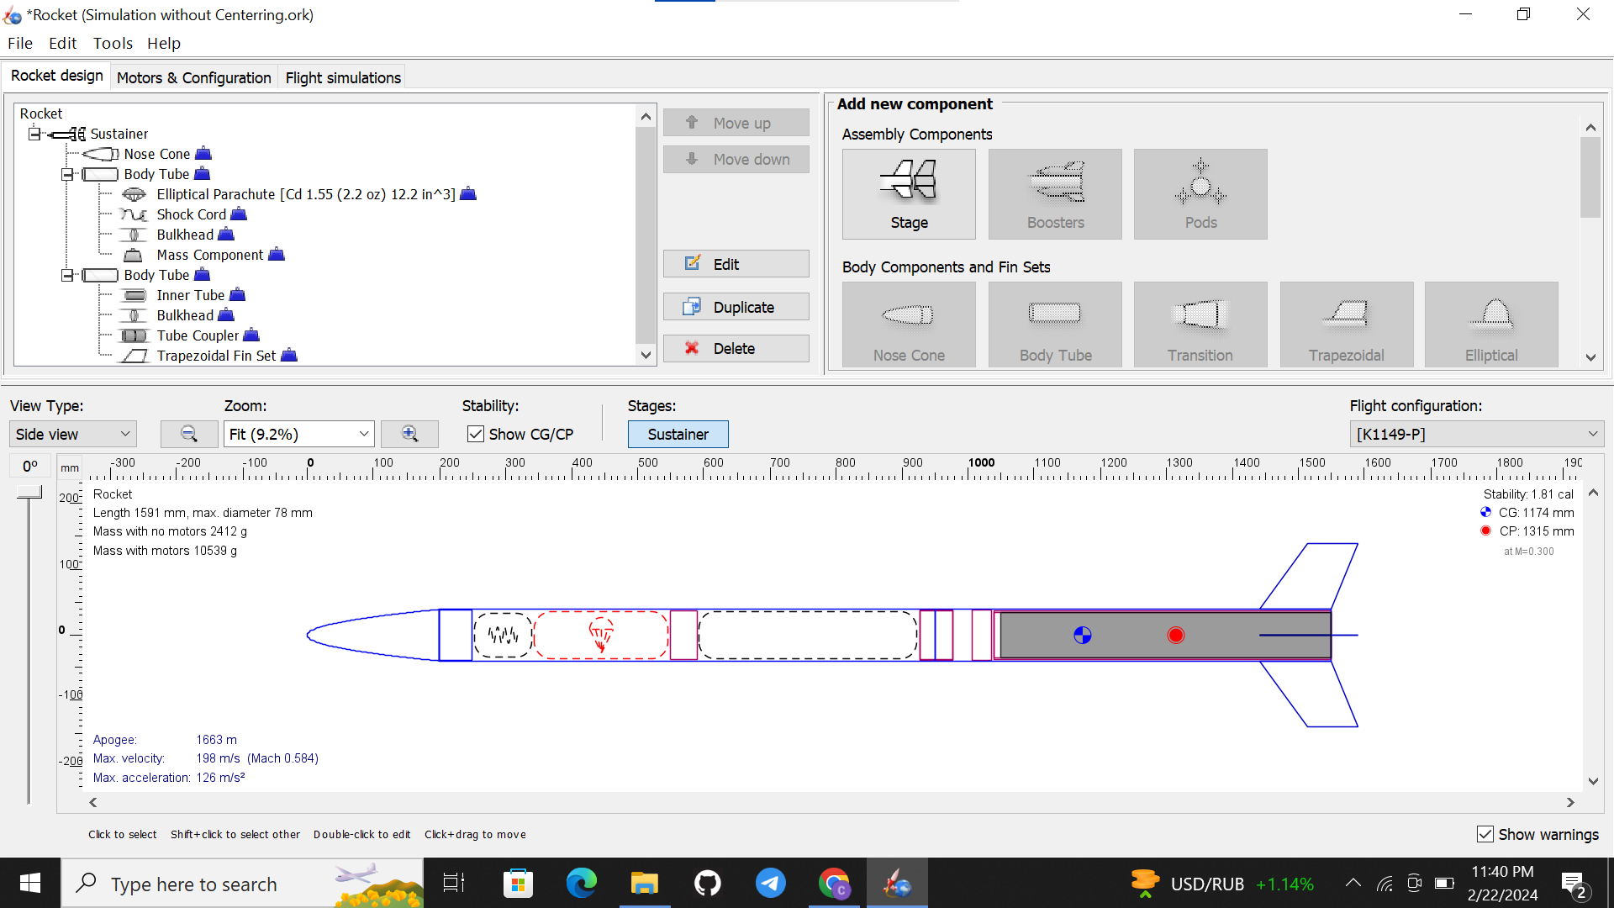
The new design to achieve a stability of 1.81 cal.

Slide 5
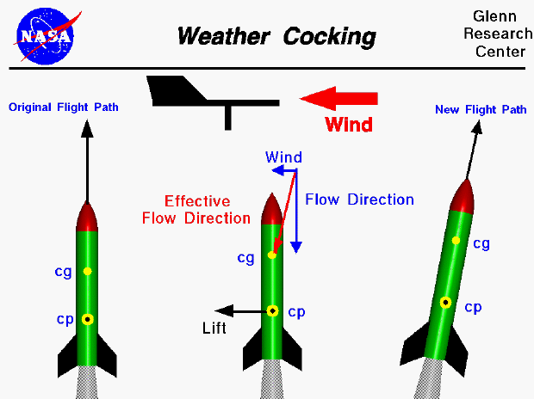
Effect of too much stability
While increasing stability is important, too much stability can lead to weathercocking, where the rocket turns into the wind during flight. Therefore, it’s important to find a balance. A stability between 1.5 and 2 calibers is generally considered acceptable for most rockets.

Slide 6
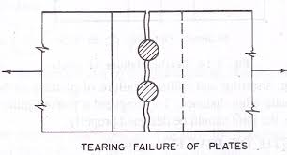
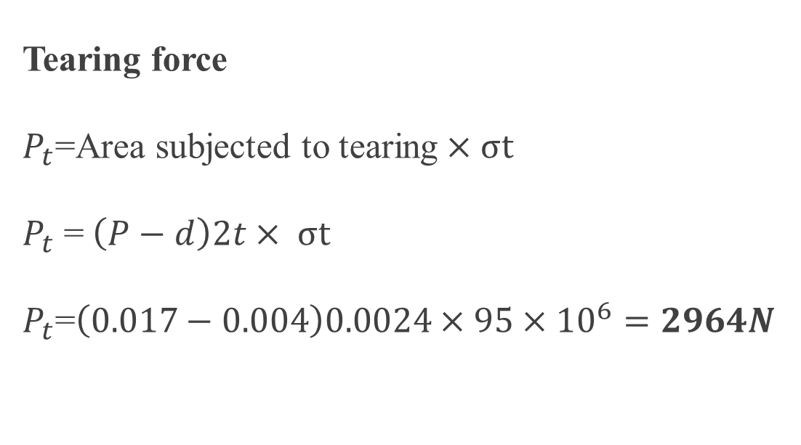
Rivet Strength Calculation
Tearing force
$P_{t}$=Area subjected to tearing$×σt$
$P_{t}$ =$\left(P−d\right)2t× σt$
$P_{t}$=$\left(0.017−0.004\right)0.0024×95×{10}^{6}=2964N$

Slide 7
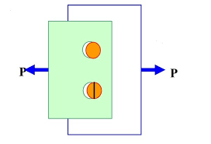
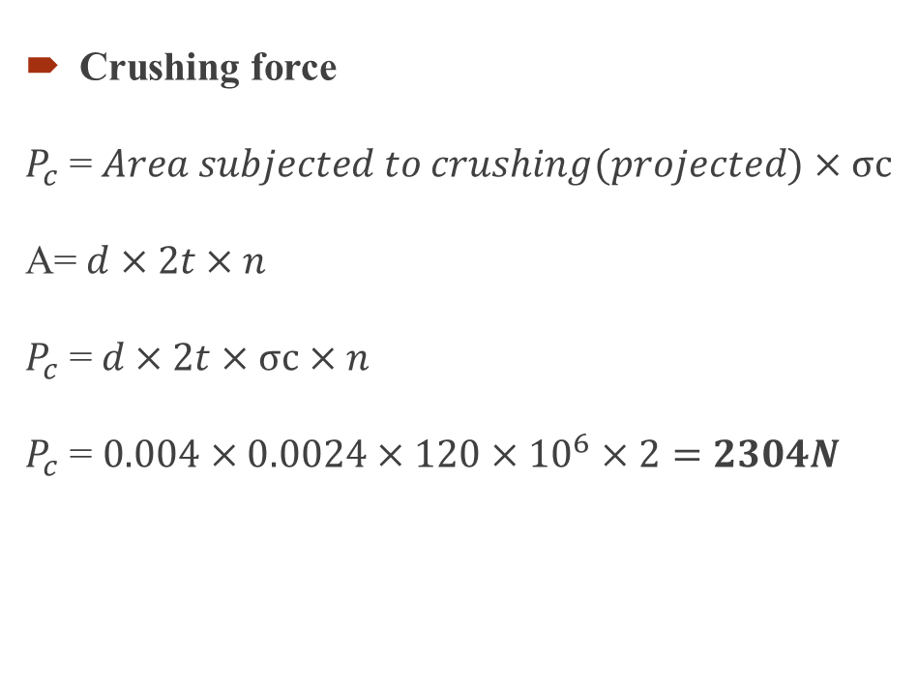
Rivet joint Strength calculation
Crushing force
$P_{c}$ =$Area subjected to crushing(projected)×σc$
A=$d×2t×n$
$P_{c}$ =$d×2t×σc×n$
$P_{c}$ = $0.004×0.0024×120×{10}^{6}×2=2304N$

Slide 8
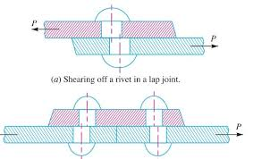
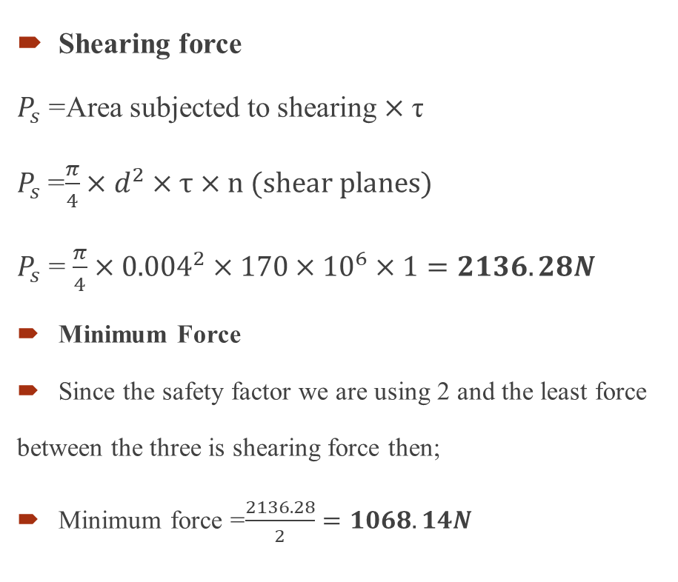
Rivet joint calculation
Shearing force
$P_{s}$ =Area subjected to shearing $×$ τ
$P_{s}$=$\frac{π}{4}×d^{2}×τ×n (shear planes)$
$P_{s}$ = $\frac{π}{4}×{0.004}^{2}×170×{10}^{6}×1=2136.28N$
Minimum Force
Since the safety factor we are using 2 and the least force between the three is shearing force then;
Minimum force =$\frac{2136.28}{2}=1068.14N$

Slide 9
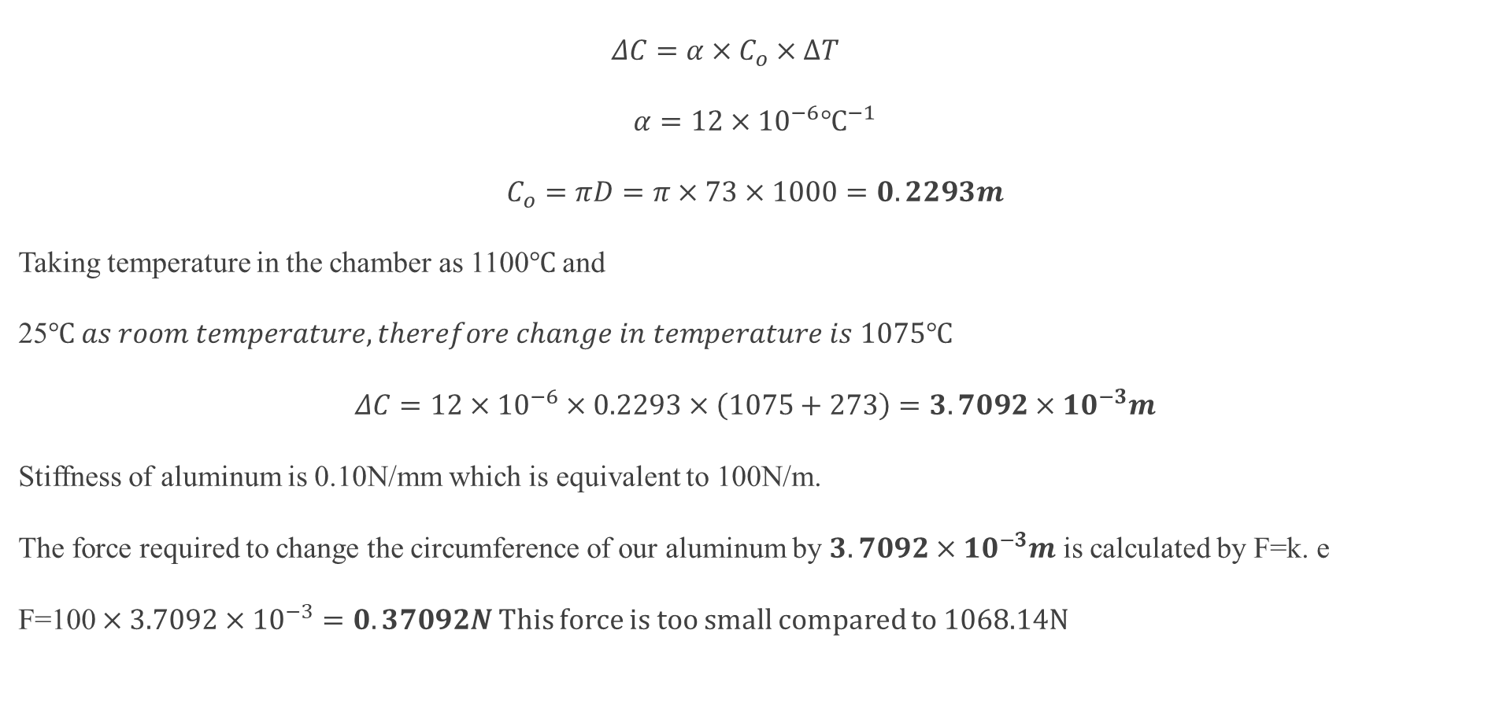
Change in circumference due to heat
$$ΔC=α×C_{o}×∆T$$
$$α=12×{10}^{−6}℃^{−1}$$
$$C_{o}=πD=π×73×1000=0.2293m$$
Taking temperature in the chamber as 1100$℃$ and 25$℃ as room temperature, therefore change in temperature is 1075℃$
$$ΔC=12×{10}^{−6}×0.2293×\left(1075+273\right)=3.7092×{10}^{−3}m$$
Stiffness of aluminum is 0.10N/mm which is equivalent to 100N/m.
The force required to change the circumference of our aluminum by $3.7092×{10}^{−3}m$ is calculated by F=k. e
F=100 $×3.7092×{10}^{−3}=0.37092N$ This force is too small compared to 1068.14N

Slide 10
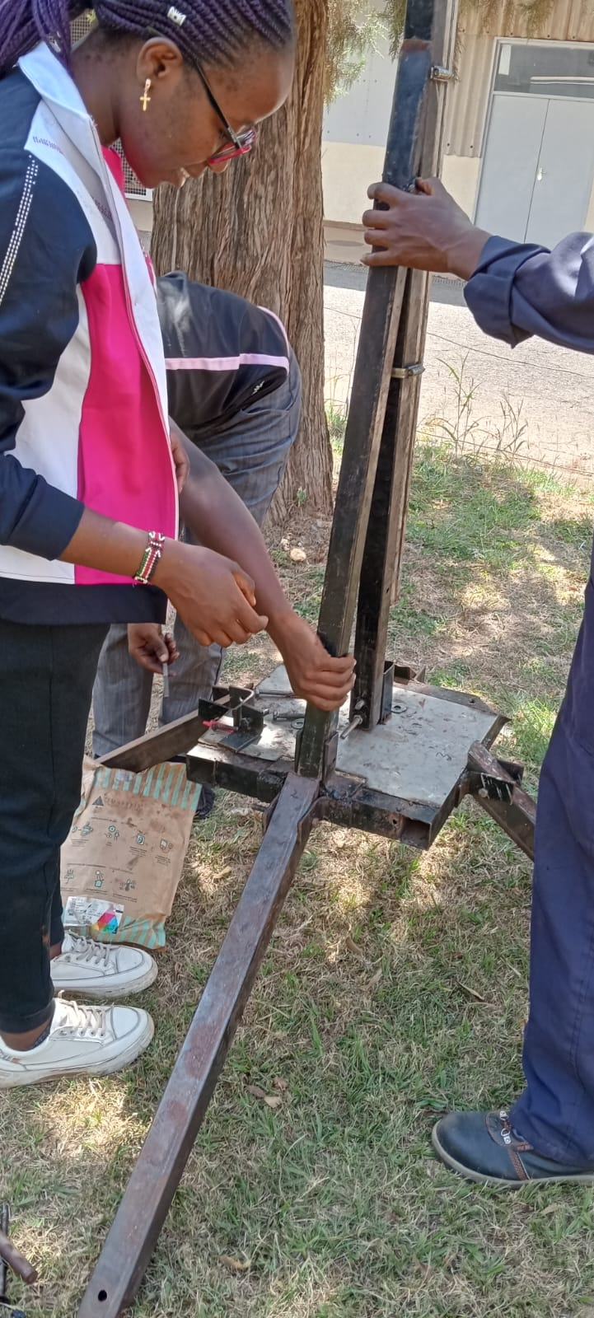
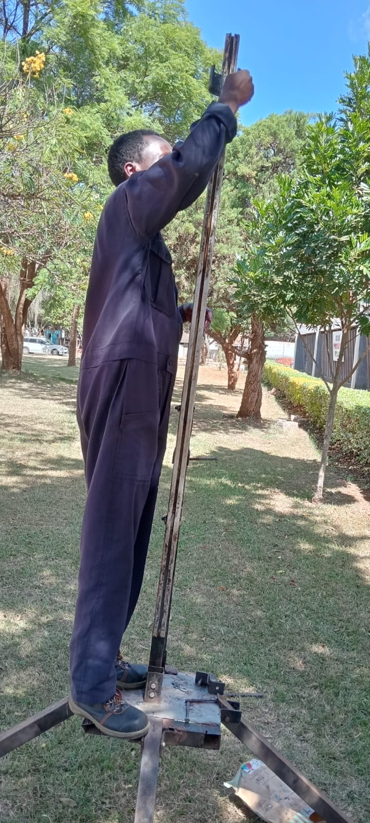
Launch pad inspection
We found that;
1. Some bolts and nuts were missing.
2. Launch lug was tightly held by the rail.
3. Launch pad is in good condition.

Slide 11
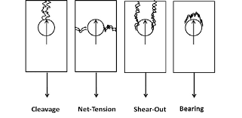
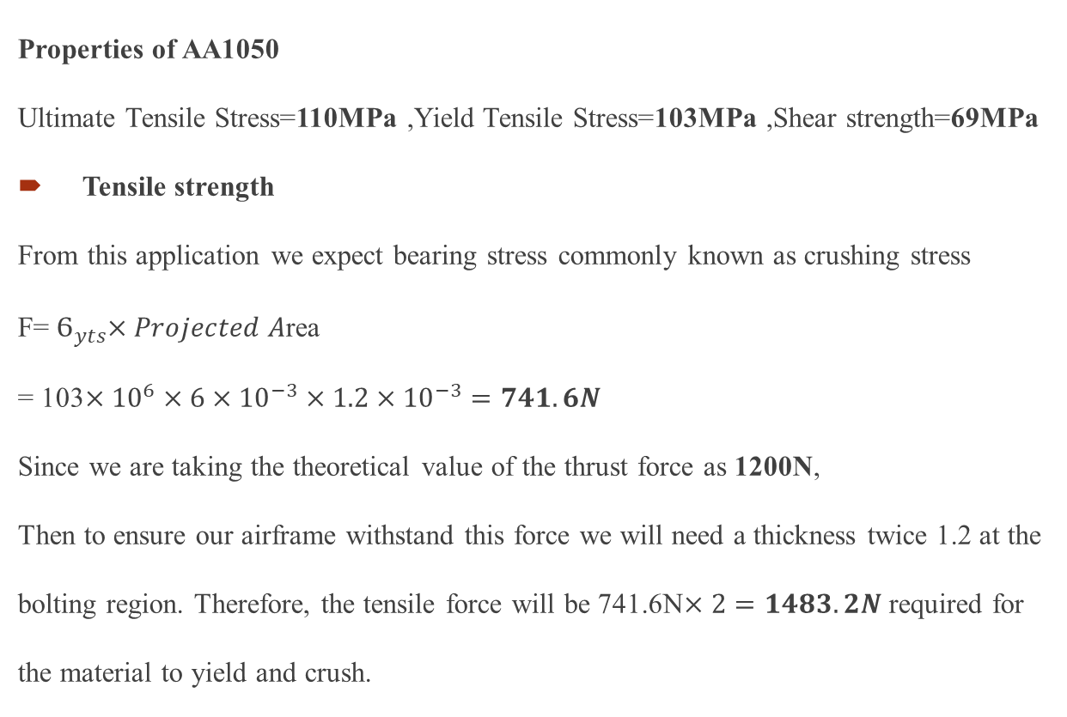
Strength Calculation of AA1050
Properties of AA1050
Ultimate Tensile Stress=110MPa ,Yield Tensile Stress=103MPa ,Shear strength=69MPa
Tensile strength
From this application we expect bearing stress commonly known as crushing stress
F=${ Ϭ}_{yts}×Projected A$rea
= 103$×{10}^{6}×6×{10}^{−3}×1.2×{10}^{−3}=741.6N$
Since we are taking the theoretical value of the thrust force as 1200N,
Then to ensure our airframe withstand this force we will need a thickness twice 1.2 at the bolting region. Therefore, the tensile force will be 741.6N$×2=1483.2N$ required for the material to yield and crush.

Slide 12
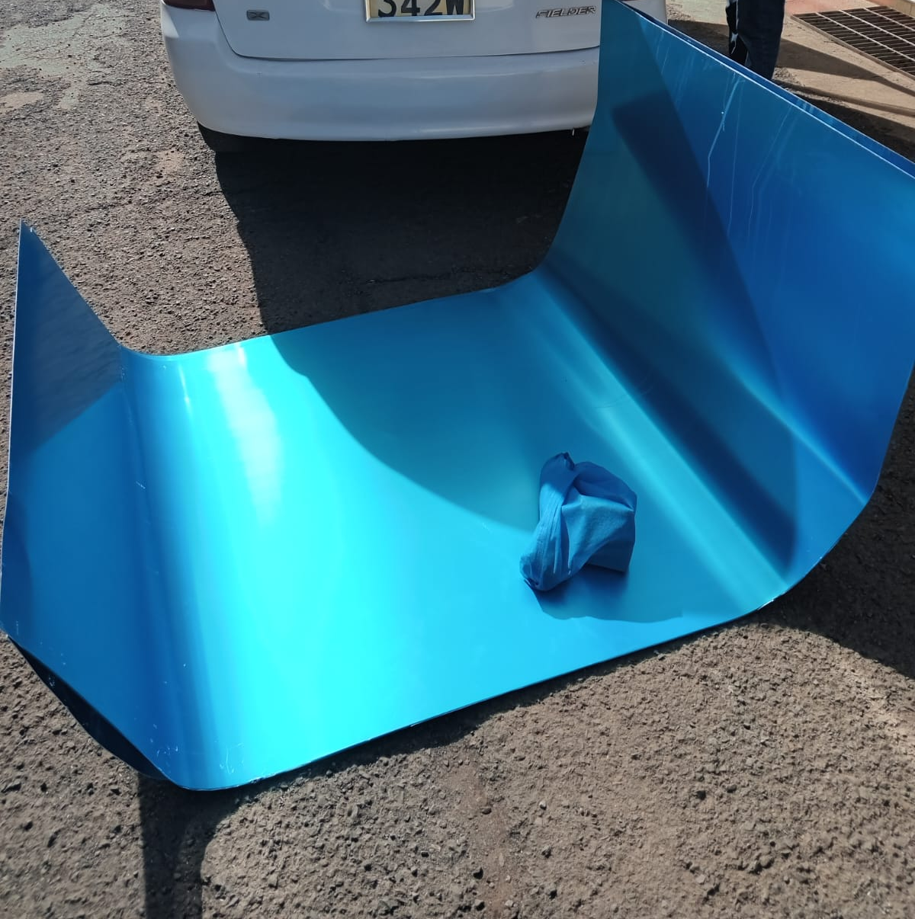
Material Acquisition
Aluminum sheet of 1.2mm thickness and grade AA1050

Slide 13
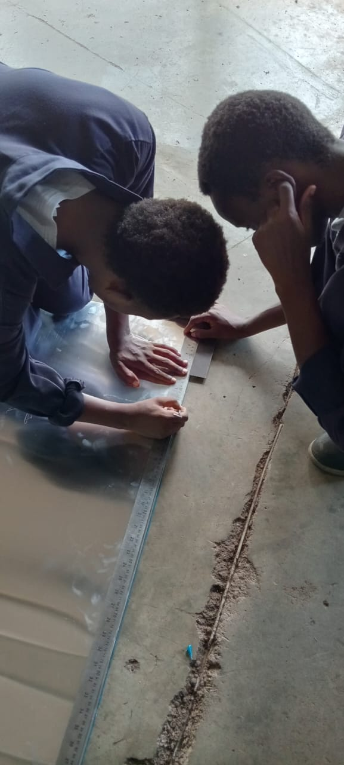
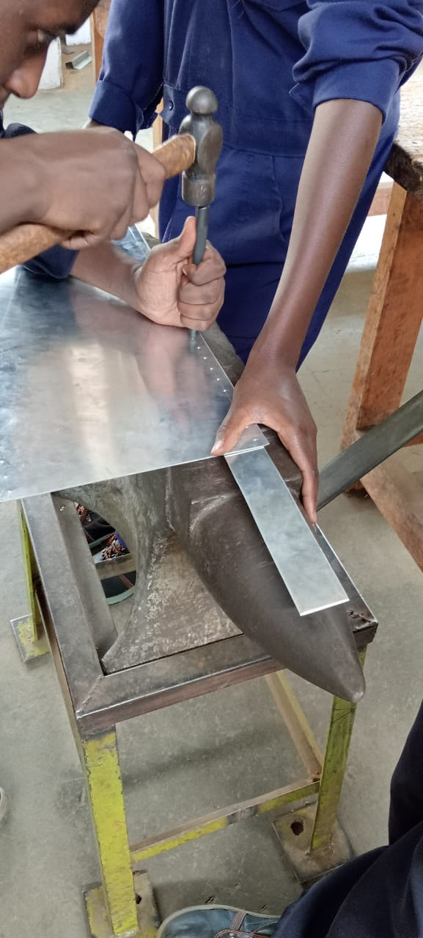
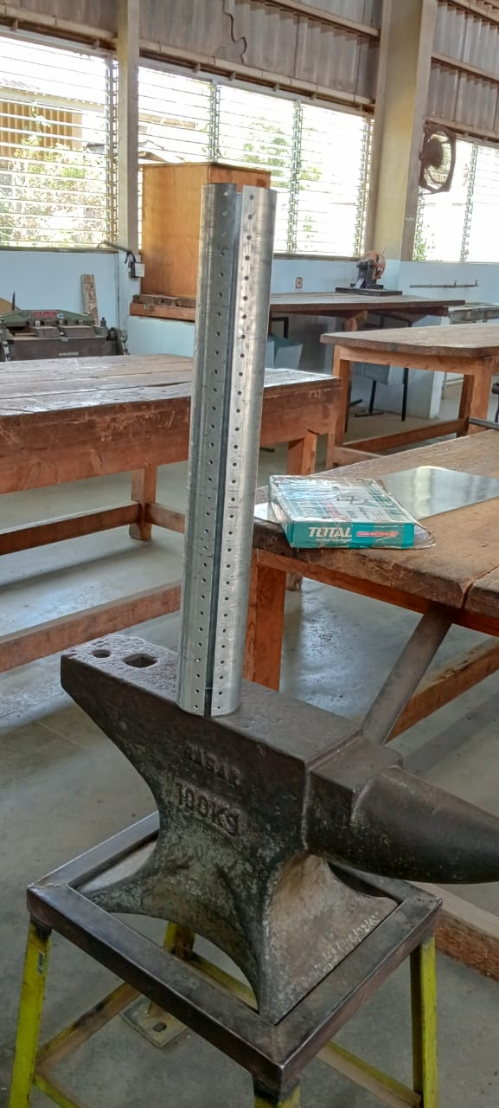
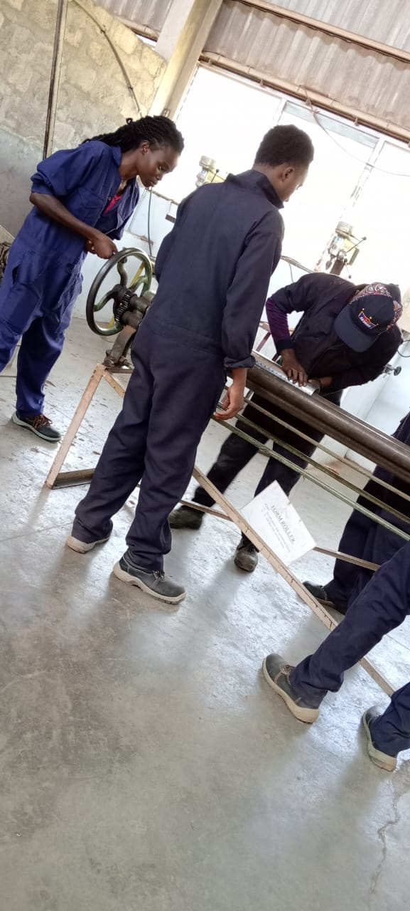
Fabrication of Airframe

Slide 14
Remaining tasks
Fabrication of the airframes
Fabrication of deflector plate
Design and fabrication of parachute
Redesigning of launch lug
3D printing of the nose cone

Slide 15
THANK YOU

